Slide 1
Rinse Over Run Report
RnD Team

Slide 2
Overview of our algorithm
We split data in 6 different subsets according to the recorded phases of the process in the test set and the corresponding recipe and train one model (random forest) for each subset.
To predict the final rinse total turbidity liter we identified that given the measurements of the last phase recorded the other phases measurements are independent from the predicted target. (E.g. Process 20010 in the test set had measurements from all the phases, our algorithm only used the measurements from the acid phase)
The caustic phase if the exception to the previous statement. If the caustic phase was the last phase recorded, the pre rinse phase measurement were considered for the model. This leads us to assume that given the caustic phase, the final rinse phase is not independent from the pre rinse phase. This is important for the process with recipe 11001.

Slide 3
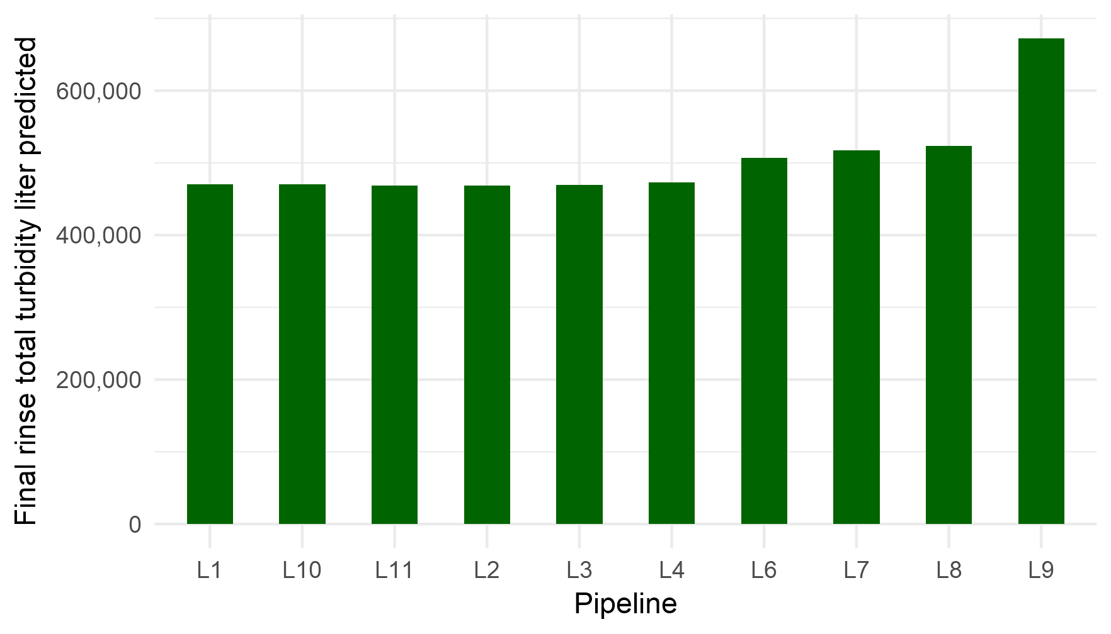
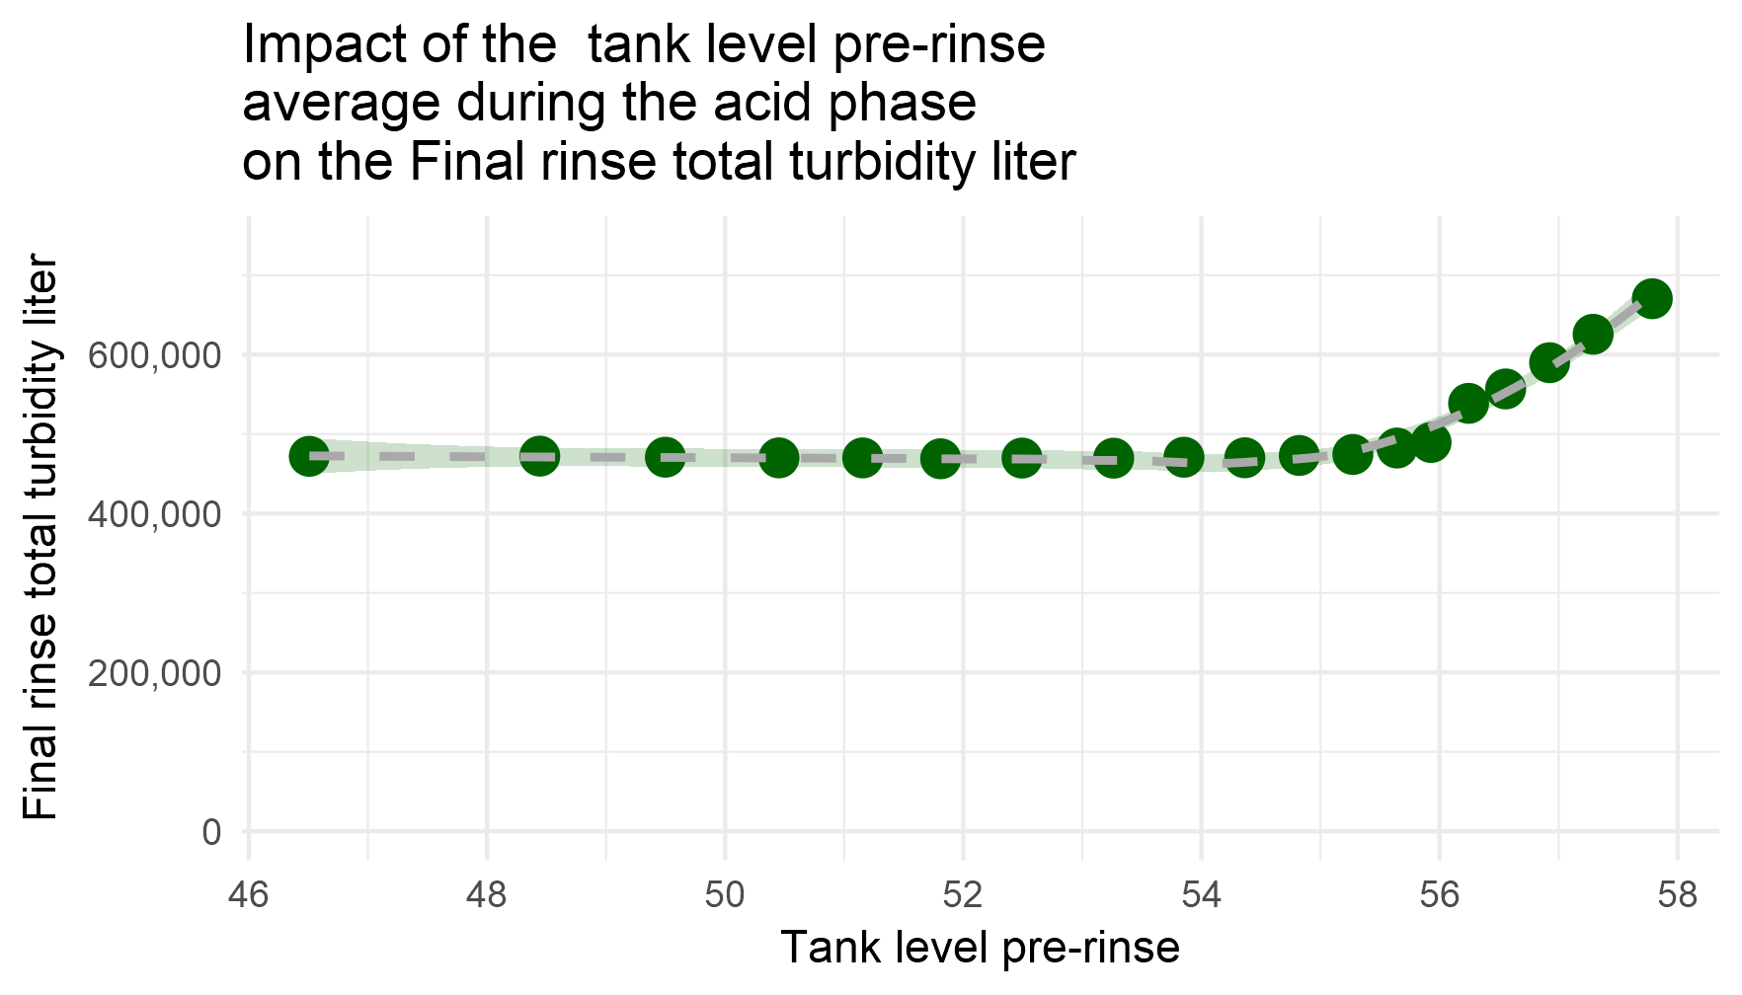
Sensitivity
The impact of the variables presented on the following slides are under de assumption that the acid phase was observed.

